Slide 1
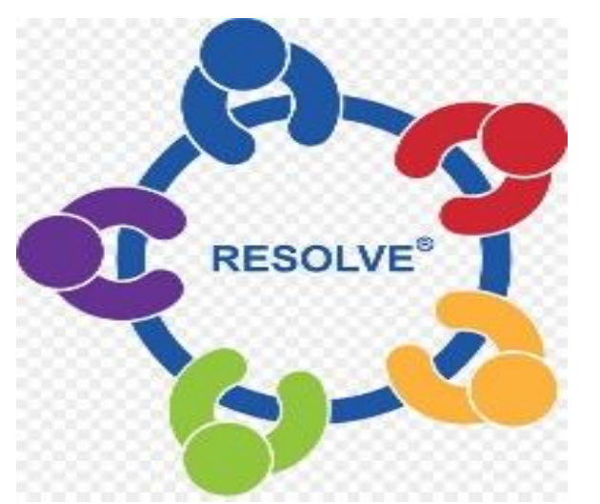
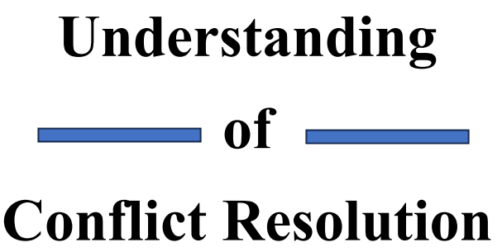
Chapter One: Understanding of Conflict Resolution

Slide 2
Chapter Objectives
Define Conflict and Conflict Resolution
Understand principles of Conflict Resolution
Identify Importance of Conflict Resolution
Understand Causes and Consequence of Conflict

Slide 3
Introduction
Conflict is a natural part of human interaction, arising from differences in perspectives, needs, and interests.
Whether it occurs in personal relationships, workplaces, or within communities, conflict can be disruptive and damaging if left unresolved.
Conflict resolution is the process of addressing and resolving these conflicts in a constructive and mutually beneficial manner.

Slide 4
Introduction
Conflict resolution involves more than simply "winning" or "losing" a dispute. It emphasizes effective communication, active listening, empathy, and negotiation skills to facilitate a productive dialogue between conflicting parties.
Conflict resolution seeks to find creative and sustainable solutions that address the underlying issues and prevent future conflicts by focusing on common ground, generating options, and encouraging compromise.

Slide 5
Definition of Conflict
Conflict (noun): conflicts (plural noun) is a serious disagreement or argument
Conflict comes From the Latin word for ‘to clash or engage in a fight,’ a confrontation between one or more parties aspiring towards incompatible or competitive means or ends.
Conflicts are primarily an expression of opposing interests.

Slide 6
Definition of Conflict
Conflict is a state of disagreement; disharmony intra and interstate conflicts have become common in the contemporary world.
These conflicts do not confine themselves within the locus of their origin; rather, they spread across other sovereign states, thereby constituting a threat to international peace and security.

Slide 7
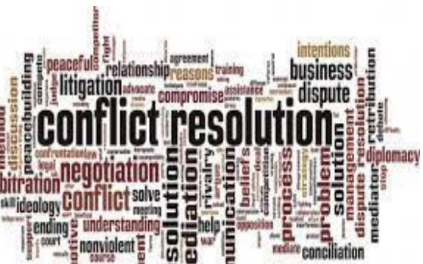
Definition of Conflict Resolution
Conflict resolution is the process of addressing disputes and finding mutually acceptable solutions.
It involves managing and mitigating the negative consequences of conflicts while promoting positive outcomes.
Understanding the nature of conflict is the first step toward effective resolution.

Slide 8
Definition of Conflict Resolution
Conflicts can be classified into different types, including interpersonal conflicts, organizational conflicts, and societal conflicts.
Interpersonal conflicts often arise from personal differences, miscommunications, or incompatible goals
Organizational conflicts can stem from power struggles, resource allocation issues, or differences in corporate culture.
Societal conflicts, on the other hand, involve broader issues like political, economic, or cultural disparities.

Slide 9
Definition of Conflict Resolution
One key aspect of conflict resolution is recognizing that not all conflicts are inherently negative.
Constructive conflicts can stimulate creativity, innovation, and positive change.
However, when conflicts escalate or become destructive, they can lead to strained relationships, reduced productivity, and long-lasting negative consequences

Slide 10
Definition of Conflict Resolution
In addition to understanding the nature of conflicts, effective conflict resolution requires developing essential skills and include:
Communication
Active listening
Emotional intelligence
Problem-solving skills
Cultural competence

Slide 11
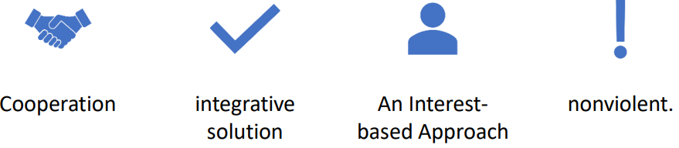
THE PRINCIPLES OF CONFLICT RESOLUTION
Four basic principles underlie most approaches to conflict resolution:

Slide 12
THE PRINCIPLES OF CONFLICT RESOLUTION
Cooperation
A key feature of conflict resolution is the focus on cooperation rather than competition.
The parties see the problem facing them as one on which they can collaborate to find a solution that suits them both.

Slide 13
THE PRINCIPLES OF CONFLICT RESOLUTION
Integrative Solutions
Follett (1940) first referred to the search for integrative solutions, that is, solutions that meet the interests and needs of all parties
She and another woman disagreed about whether to open or close a window.
The compromise solution, that is, having it half open, would satisfy neither of them.
Eventually they came up with “win-win” solution of opening a window in an adjoining room.

Slide 14
THE PRINCIPLES OF CONFLICT RESOLUTION
An Interest-based Approach
Conflict resolution approaches focus on the deeper issues or interests underlying the conflict, pursuing a new and creative solution that is better than either of the parties’ initial positions. This is known as an interest-based approach.
The underlying interests behind a conflict can include needs, wants, fears, and concerns and emerge through “unpacking” the competition and each party’s initial positions.

Slide 15
THE PRINCIPLES OF CONFLICT RESOLUTION
Nonviolence
Non-violence is another key principle underlying conflict resolution: a commitment to the values of peace and nonviolence.
Although one commonly talks about “conflict resolution,” what is usually implicit is more fully expressed as “nonviolent conflict resolution.”
“Resolving” a conflict using arms, for example, is not considered a form of conflict resolution.

Slide 16
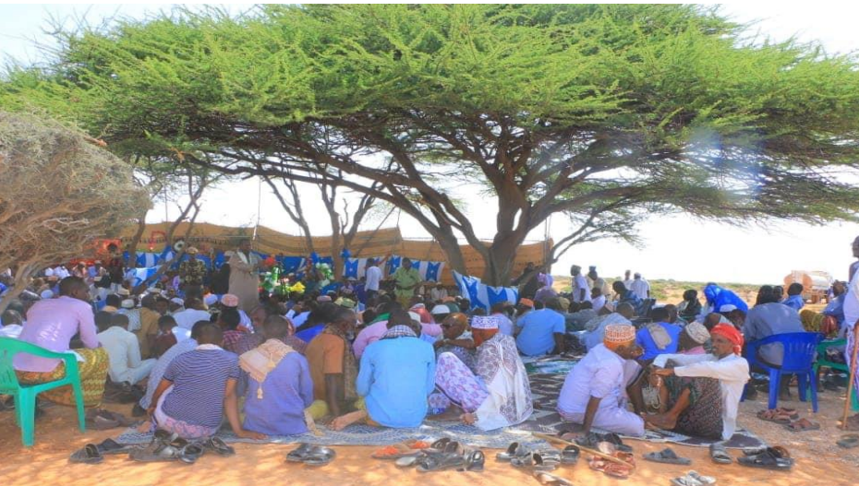
Importance of Conflict Resolution
Conflict resolution skills are crucial in various aspects of life
Here are some key reasons why conflict resolution skills are essential:

Slide 17
Importance of Conflict Resolution
Improved Relationships
Enhanced Workplace Productivity
Effective Problem-Solving
Reduced Stress and Improved Well-being
Positive Organizational Culture
Peaceful Coexistence
Personal Growth and Development

Slide 18
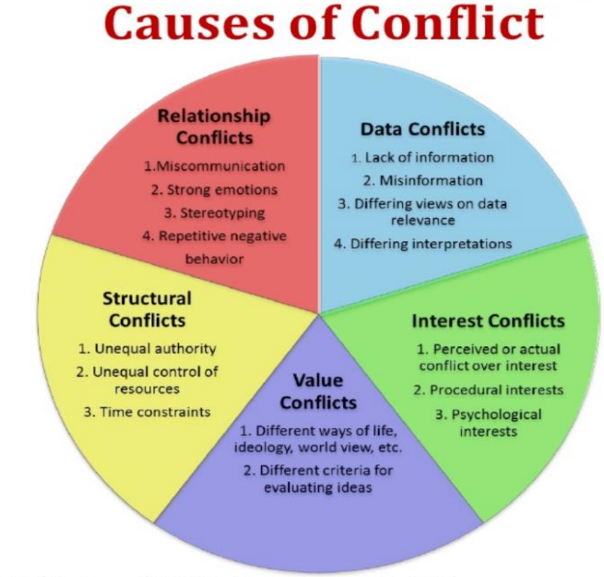
CAUSES AND CONSEQUENCES OF CONFLICT

Slide 19
CAUSES AND CONSEQUENCES OF CONFLICT
Causes of conflict
Conflict is an ever-present aspect of human interactions, permeating our personal lives, workplaces, communities, and global affairs.
There are five common causes of conflict:
Relationship Conflict: Relationship conflict refers to conflicts arising from interpersonal issues, tensions, or individual disagreements.

Slide 20
CAUSES AND CONSEQUENCES OF CONFLICT
Data Conflict: The source of this kind of conflict is the lack of information, misinformation, different views of the relevance of the data, or interpretations of what the data means.
Structural Conflict: The source of this kind of conflict is unequal power, authority, influence/voice, control of resources, or time constraints.
Value Conflict: These conflicts are caused by differing world views or criteria for evaluating ideas.

Slide 21

CAUSES AND CONSEQUENCES OF CONFLICT
Interest Conflict: The source of this kind of conflict is based on competing or conflicting interests, interests around the procedure for deciding or negotiating an outcome, or psychological interests (status, power, identity, autonomy, etc.)

Slide 22
CAUSES AND CONSEQUENCES OF CONFLICT
The Consequences of Conflict
While conflict is often associated with negative connotations, it is essential to recognize that its consequences can be multifaceted, encompassing both positive and negative outcomes.
Conflict has the potential to bring about profound changes, catalyzing growth, innovation, and resolution.

Slide 23
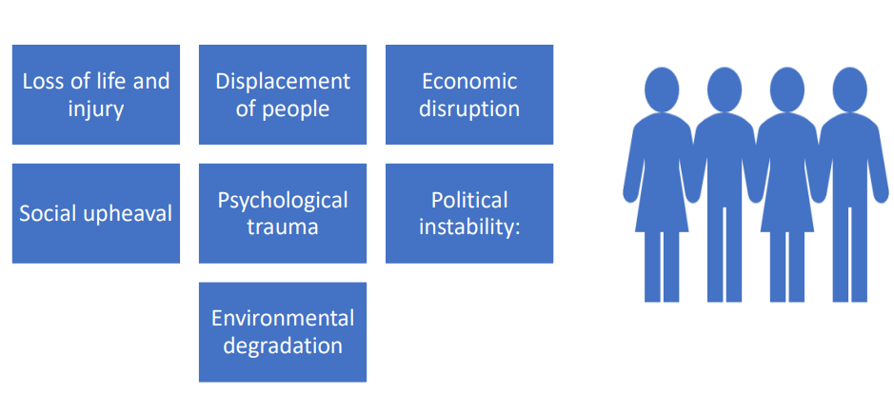
CAUSES AND CONSEQUENCES OF CONFLICT
The below shows Negative consequences of conflict:

Slide 24
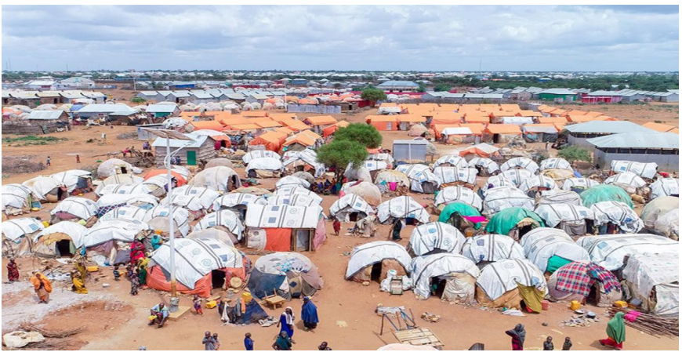
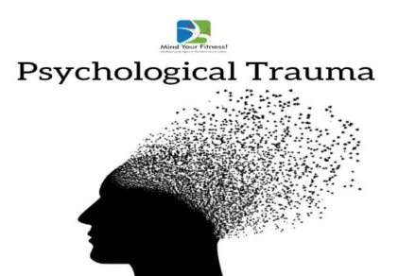
CAUSES AND CONSEQUENCES OF CONFLICT

Slide 25
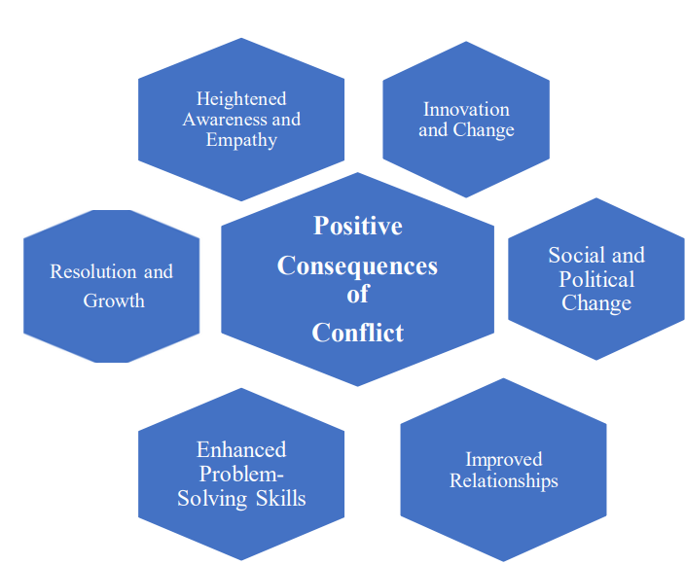
CAUSES AND CONSEQUENCES OF CONFLICT
This figure shows the positive Consequences of Conflict:

Slide 26
THE END

